Slide 1

Lariat Fleet Planning
Fiscal Year 2019

Slide 2

Fiscal Year 2019 Fleet Planning
Looking for greatest profit return
Five strategies to use

Slide 3
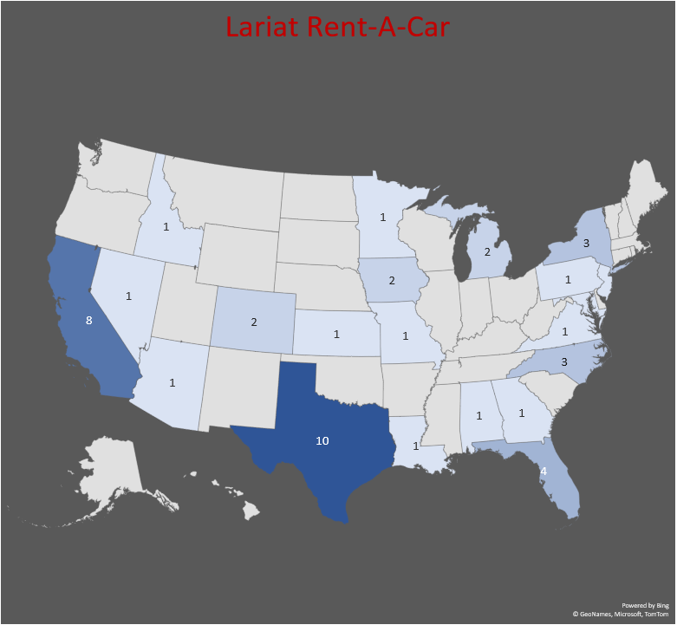
Fiscal Year 2018
Fleet of 4,000 cars
With 50 branches in 22 states

Slide 4
Fiscal Year 2018

Slide 5
Strategy 1
Add 100 of your “Top Ten” revenue producing cars
Keep current rates
Assume same rental lengths and number of closed agreements
Increase of net revenue/per car

Slide 6
Strategy 2
5% of your cars perform at a loss
Top ten versus bottom ten

Slide 7
Strategy 2
Liquidate the 200
Assume constant growth/rental rates/and cost
Keep profit from sold cars and put back into branches.

Slide 8
Strategy 3
Liquidate 378 cars
Assume constant growth/rental rates/and cost
Keep profit from sold cars and put back into branches.

Slide 9
Strategy 4
Increase rates by 10%
Assume constant growth/rental length/and cost

Slide 10
Strategy 5
Sell 200 insolvent cars
Buy 200 “Top Ten” cars
Increase growth by 20%
Increase rates by 10%
Assume constant rental length

Slide 11
Strategy 5 is the best solution:
Increase Rentals with more desirable vehicles
1
Drop $500 thousand vehicle upkeep costs
2
Add $21.5 million in net revenue
3

